Slide 1
Comparison of Deep vs Shallow Learning using IMDB Review Classification
Sean Northcutt, Johnnie Oldfield, Andrew Russell

Slide 2
The Problem
Compare two methods of separating the polarity of IMDB Reviews
One method of implementation is using Naive Bayes
The other is using Keras Deep Learning

Slide 3
The Dataset
The data is imported from Keras
Contains 50,000 reviews in a 50/50 split we couldn’t change
Using a random seed we shuffled the reviews
Each review is an array of integers with each number meaning how frequent a word is
Example review:
[1,1713,28,13,110, ... ,19,49,220,1322,538]

Slide 4
Naive Bayes
Probabilistic Classifier that applies Bayes Theorem
Assumes all features are independent
Basically takes the probabilities an unknown happens in every class and applies the highest of all the probabilities to that unknown

Slide 5
Implementation
Placed all words in the training set in a dictionary that contained their word counts
Took the log of each probability given negative divided by probability given positive
After adding all the ratios if it was below 0 it would be classified as a positive review and above 0 is negative

Slide 6
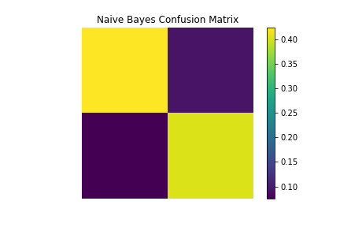
Confusion Matrix

Slide 7
Keras
High Level API adopted by Tensorflow and other back-end engines
Easy to understand and build/expand models due to modular nature
Useful for quick prototyping

Slide 8
Implementation
We utilized multiple layers of Keras to help realize the patterns to predict if a review is positive or negative
Using binary cross entropy since we only have 2 classes it will classify our results as a 0 or 1 for its decision making

Slide 9
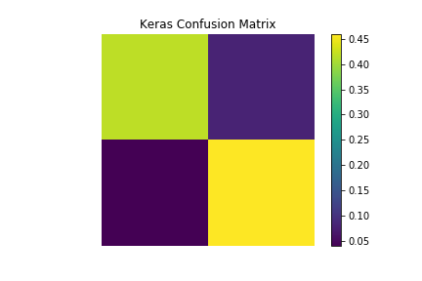
Confusion Matrix

Slide 10
Results
Naive Bayes had an average accuracy of 84% taking around 23 seconds each test
Keras had an average accuracy of 87% taking around 50 seconds each test

Slide 11
Evaluation
It is better to use a Naive Bayes method when working with this kind of data as the time to complete is 50% less than using a Deep Learning approach

Slide 12
Shortcomings
Would have been a better comparison to use data that had more classes and maybe even larger

